Slide 1

Act Locally, Impact Globally

Slide 2
Lecture 3: Handling Data Quality Problems

Slide 3
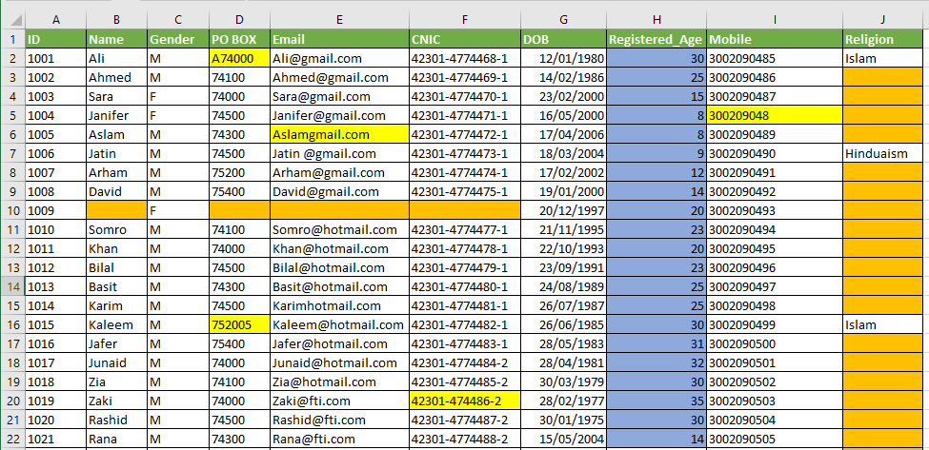
Data Quality Issues ?

Slide 4
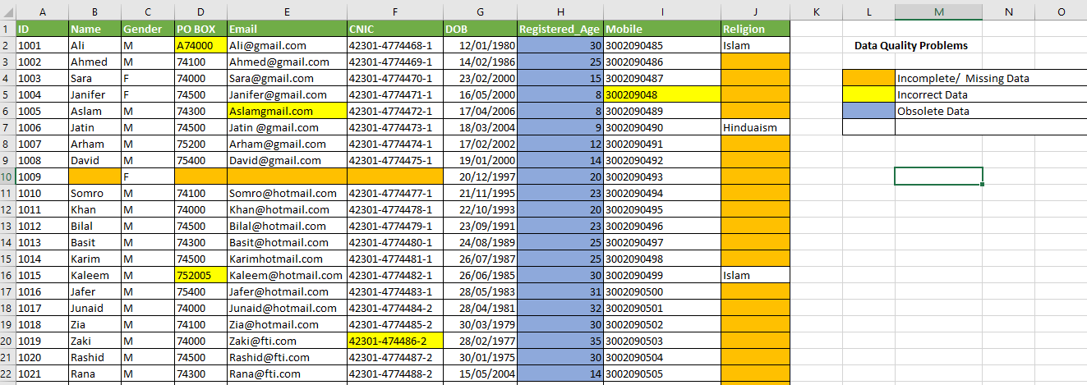
Data Quality Issues ?

Slide 5
What is Data Quality ?
Data quality is an assessment of data's fitness to serve its purpose in a given context.
The quality of data can be measured on different parameters like:
Data accuracy (The degree to which the data represents reality)
Completeness (Are there any missing values in the data?)
Validity(Does the data match the rules?)
Consistency(Is the data consistent across various data stores?)
Timeliness(Is the data relevant in present situation ?).

Slide 6
Why Data Quality ?
High-quality data is important for an organization to understand and to get the key information about current and potential customers.
It helps the organization in making right decisions in order to:
Increase customer satisfaction
Offering relevant products and services to right customers
Launching effective marketing campaigns.
Take corrective or preventive measures
Quality data also helps to keep your company’s various departments on the same page so that they can work together more effectively.

Slide 7
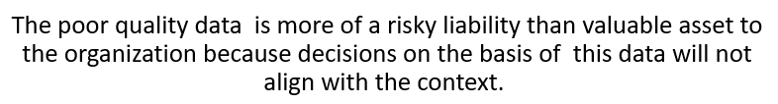
Data : Risky Liability or Valuable Asset

Slide 8
Data Quality Issues
Major data quality issues include:
Missing / Incomplete Data
Wrong / Incorrect/ Invalid Data
Obsolete / Outdated Data
Before jumping to analyse data and derive correlations , these data quality issues must be sorted out.

Slide 9
Treating Missing Data
We can handle missing values by:
Drop Null or Missing Values Altogether ( Drop the record)
Filling the Missing values manually
Labour Intensive , Domain Knowledge
Fill Missing Values using Imputation ( Mean , Median , Mode)
Predicting Missing Values with Machine Learning Algorithm
For example KNN (Compute Intensive)

Slide 10
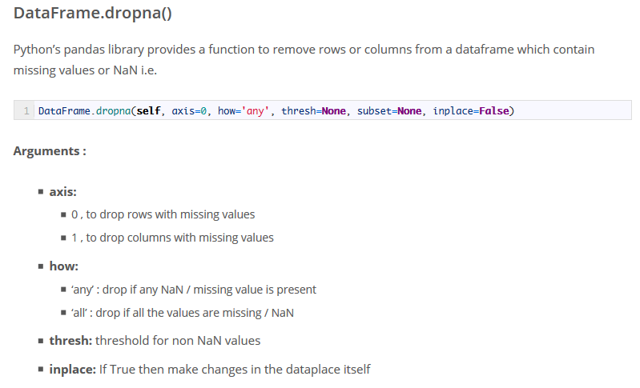
dropna()

Slide 11
Dealing with Incorrect / Invalid Data
Sometimes incorrect / invalid / garbage data values are present in data fields . For Example:
Incorrect Phone Numbers
Wrong / Invalid Email IDs
Incorrect CNIC
Numeric data where string data is required
String data where numeric data is required
This garbage data can badly affect your subsequent analysis

Slide 12
Some Pre-Requisites
Before you go for data quality assessment regarding incorrect values you must have a look at :
Names of Columns in your dataset ( you may need to change them)
The data types of your attributes ( You may need to change them also)
df.dtypes
Returns the data types of all the columns / attributes in a dataframe

Slide 13
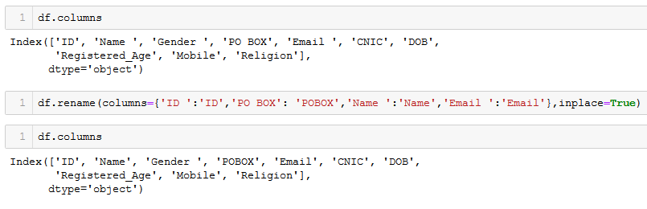
Renaming Columns

Slide 14
Renaming Columns
Datasets for analytics are extracted from various data sources
Each data source may have its own naming conventions for columns ( fields)
We may need to change column names to make coding easier and resolving any possible errors.

Slide 15
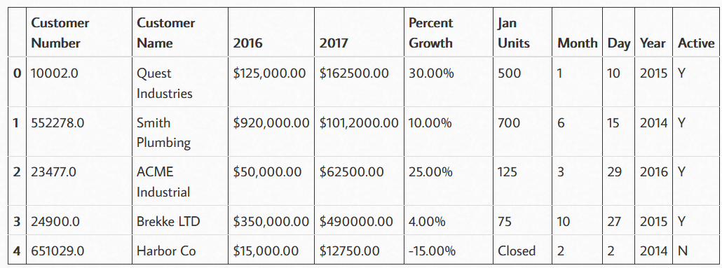
Changing Data Types – A Sample Use Case
A snapshot of sales dataset

Slide 16
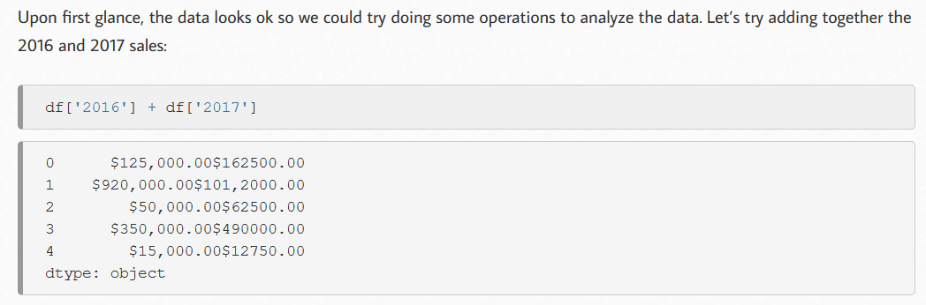
Why changing datatypes may be necessary?

Slide 17
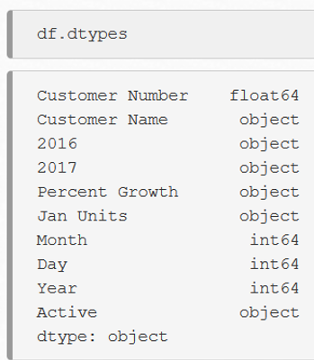
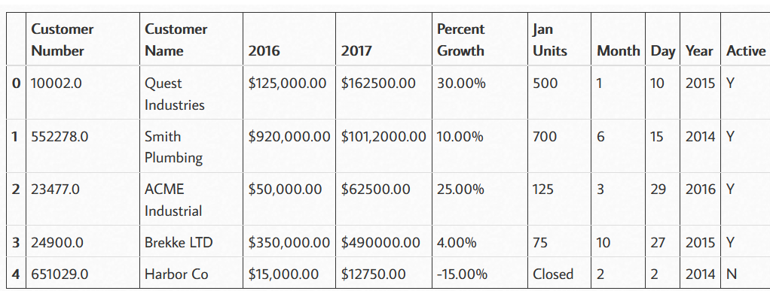
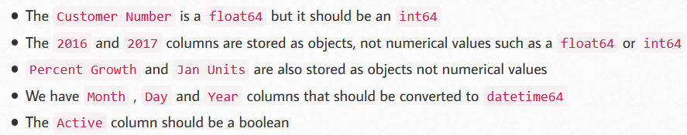
Why changing datatypes may be necessary?

Slide 18
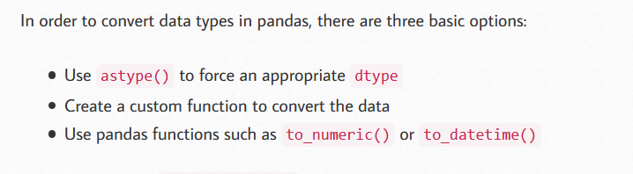
How to Covert Data Types in Pandas

Slide 19
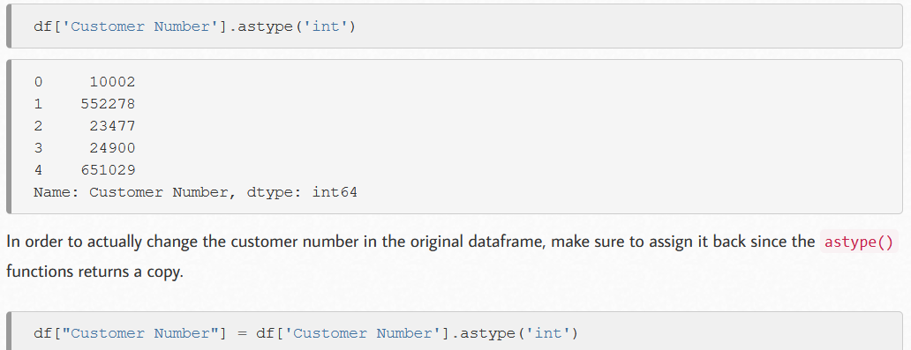
Using astype() function

Slide 20
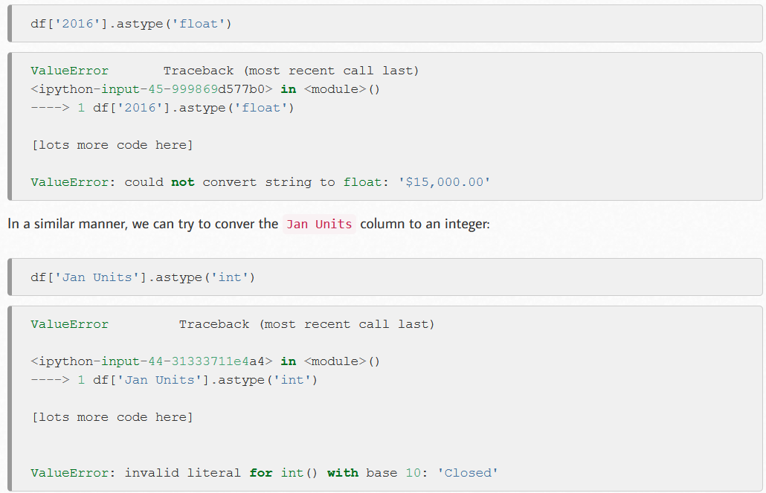
Problems with astype()

Slide 21
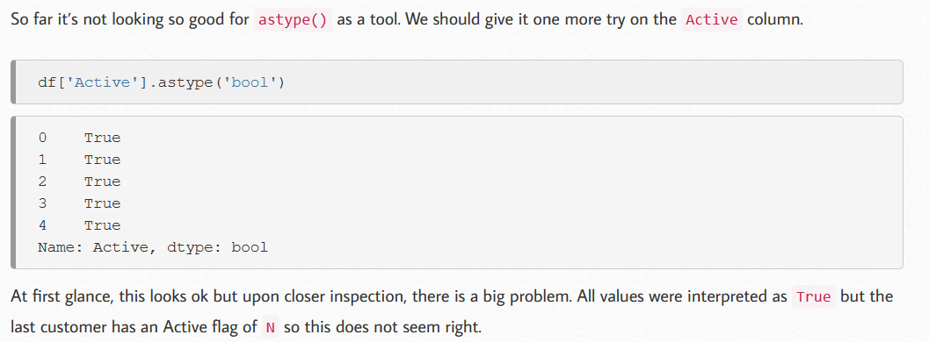
Problems with astype()

Slide 22
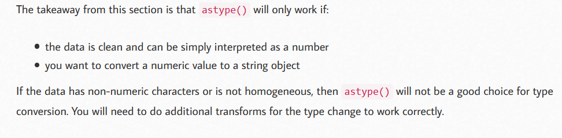
Problems with astype()

Slide 23
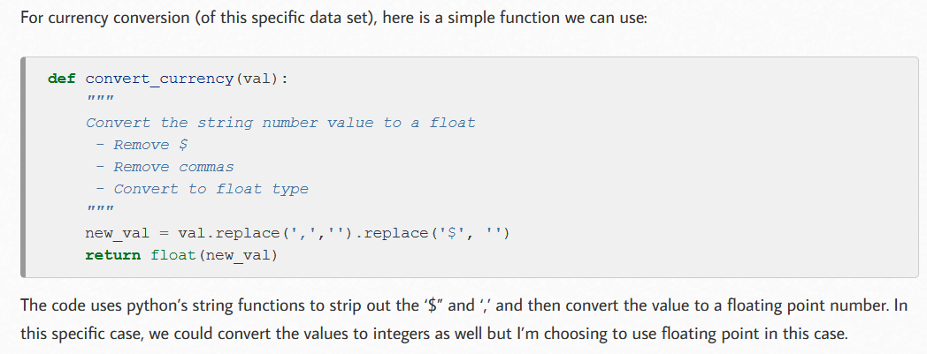
Custom Conversion Functions

Slide 24
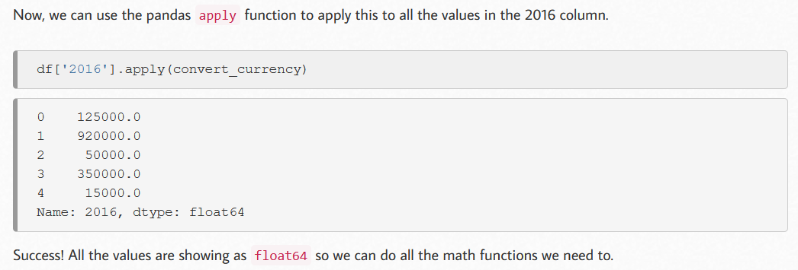
Custom Conversion Functions

Slide 25
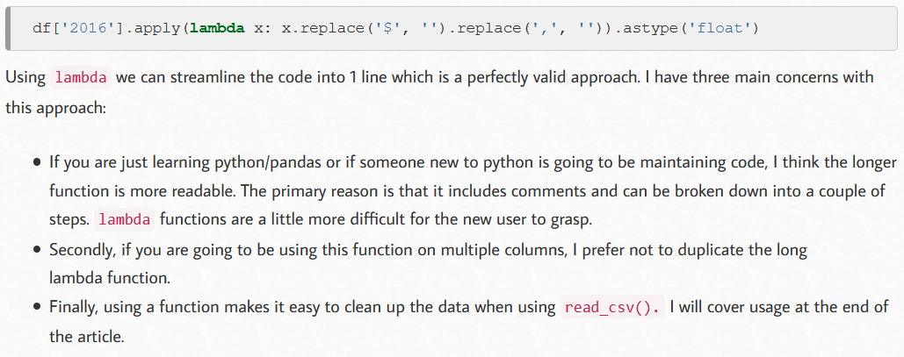
We can also use lambda functions

Slide 26
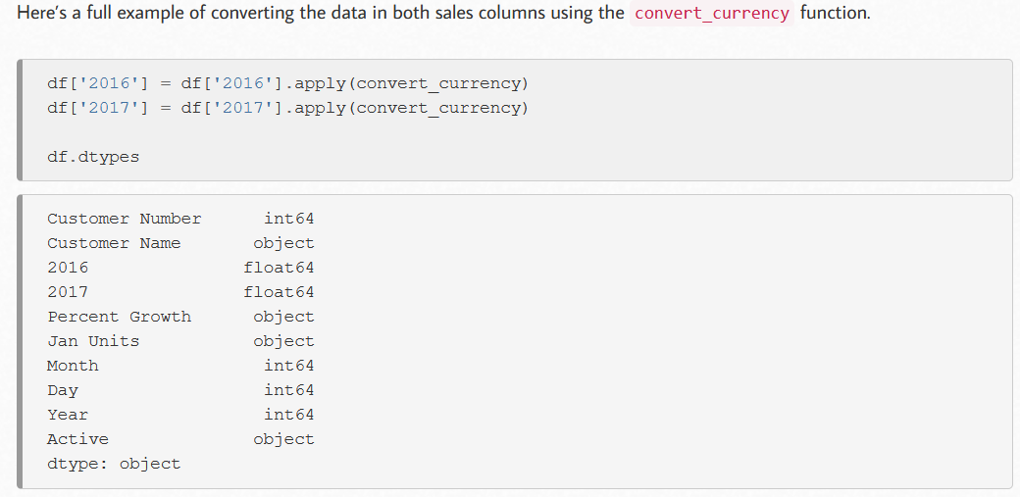
Custom Conversion Functions

Slide 27
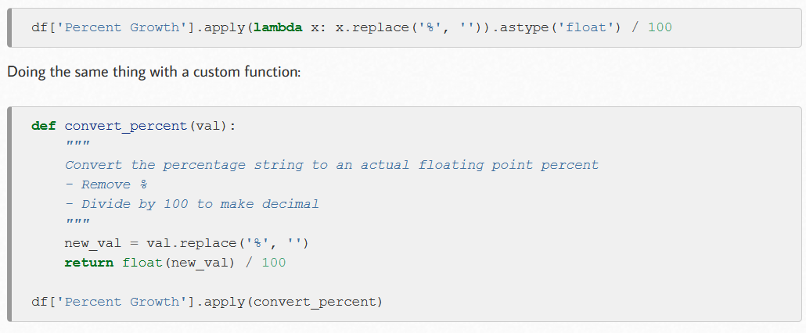
Custom Conversion Functions

Slide 28
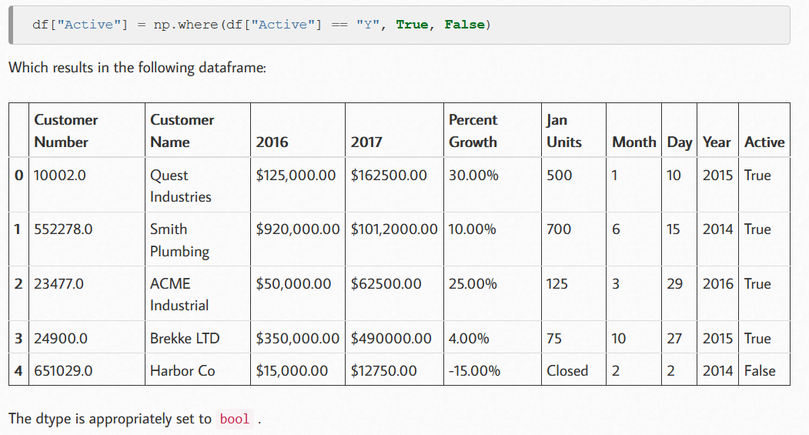
Using np.where()

Slide 29
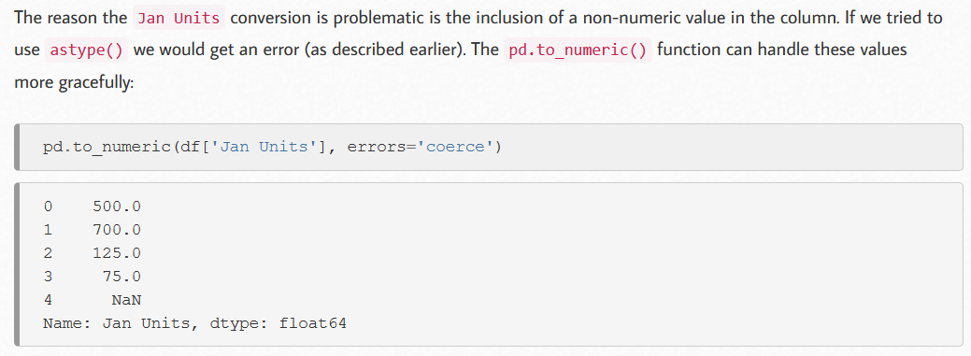
Pandas Helper Functions
Two such functions are pd.to_numeric() and pd.to_datetime()

Slide 30
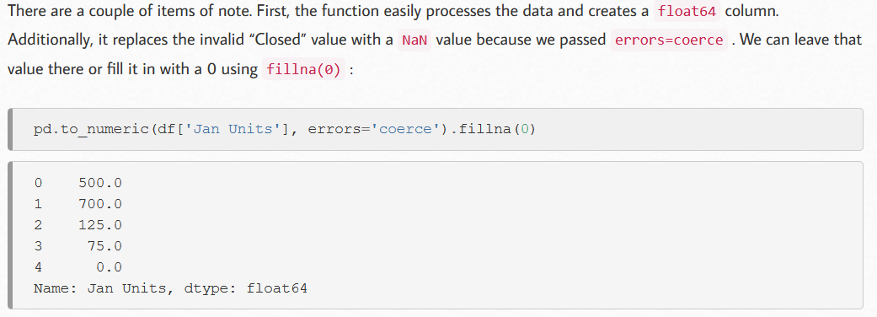
Pandas Helper Functions

Slide 31
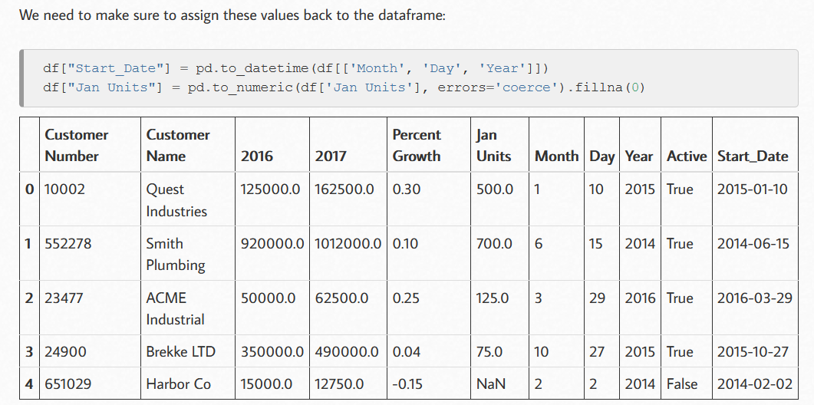
Pandas Helper Functions

Slide 32
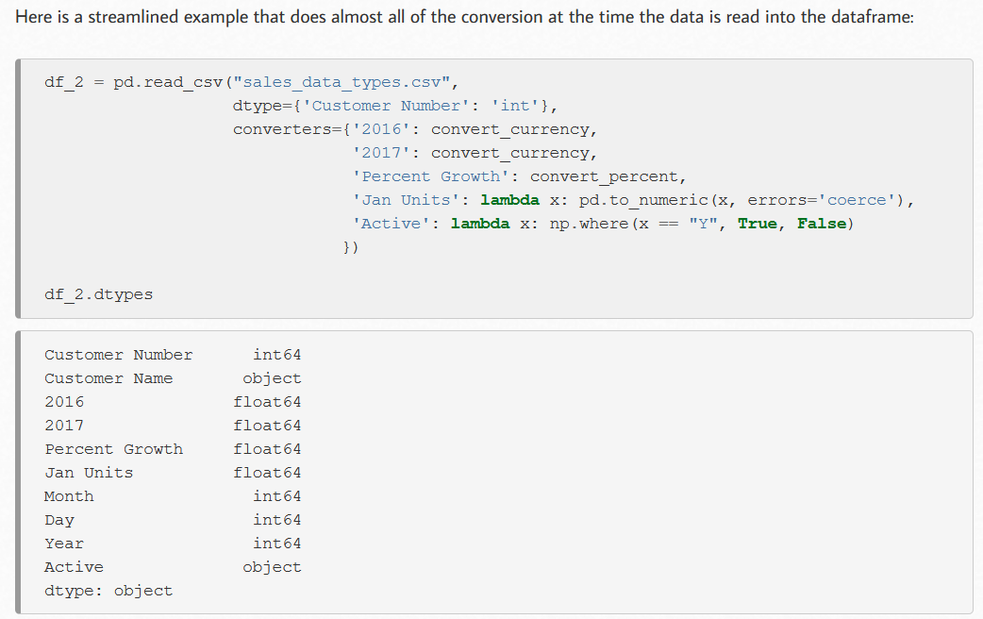
Data Type Conversion at Read Time

Slide 33

Data Validation
Customers Dataset

Slide 34
A sample Dataset – Customers Data

Slide 35
Data Validation
You must have a proper domain knowledge before you inspect whether data in a given column is correct or not.
For example , the dataset we discussed earlier is customers data who belong to Karachi. From Data ( and domain knowledge) we may infer that:
POBOX should be 5 digit long with no Alphabets
Mobile Number should be alteast 10 digits (3362090485) and maximum 15 digits long ( 009203362090484)
Email ID should contain @ character
CNIC should have a proper format #####-######-# like 12345-7891011-2

Slide 36
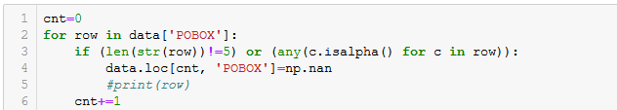
Validating POBOX

Slide 37
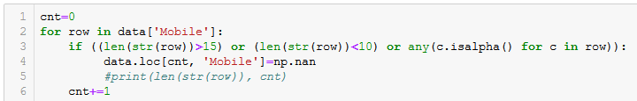
Validating Mobile

Slide 38
Validating an Email Address
An email address should contain two characters @ and .
There is always an email domain ( .com , .pk etc )
uali@iba.edu.pk
malik_usman_ali@hotmail.com
usmanali@codexnow.com
usmanali.07442@gmail.com
malik_usman_ali@yahoo.com
It is difficult to validate domain name , but we can validate on the basis of @ and . Characters
No email can be valid without these two characters

Slide 39
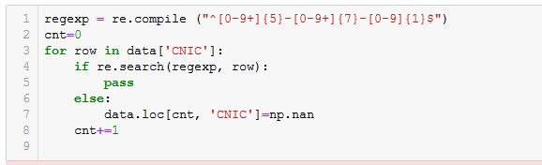
Validating CNIC

Slide 40

Validating CNIC
Must Start With this Pattern
Must end With this Pattern
A dash
Any one digit from 0-9
A five digit number
A seven digit number

Slide 41
Hands On : Handling Data Quality Issues in Python

Slide 42
Dataset : Customers
Task:
Handle Missing Values
Changing Column Names and Data Types
Handel Incorrect data
Validate ( POBOX , Mobile , Email, CNIC)
Locating incorrect data ( POBOX , Mobile , Email, CNIC)
Replacing incorrect Values with NaN
Deleting all records with NaN values
Adding a new feature ( DOB_Year)
Feature Construction from existing features ( Age_Updated)
Deleting un-necessary Columns
Saving CSV as a cleaned dataset

Slide 43

Regular Expression
A RegEx, or Regular Expression, is a sequence of characters that forms a search pattern.
RegEx can be used to check if a string contains the specified search pattern.
Python has a built-in package called re, which can be used to work with Regular Expressions.

Slide 44
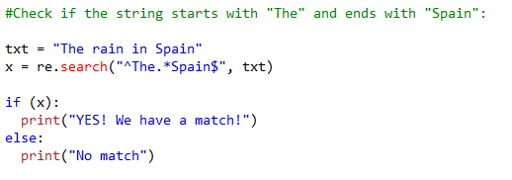
Regular Expression – Example-1

Slide 45
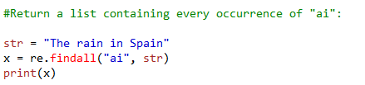
Regular Expression –Example 2

Slide 46
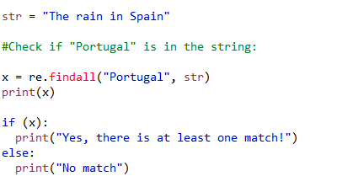
Regular Expression Example 3

Slide 47
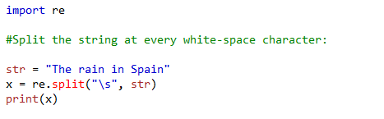
Regular Expressions - Example 4

Slide 48
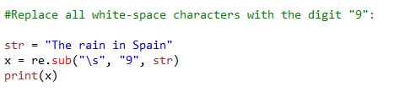
Regular Expressions – Example 5

